Slide 1


PROJECT RUNNING MACHINE

Slide 2




COMPONENTS & BUDGET
FLOW DIAGRAM
CIRCUIT
TESTS

Slide 3

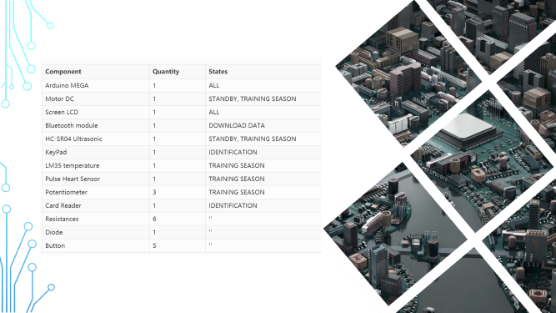
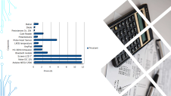
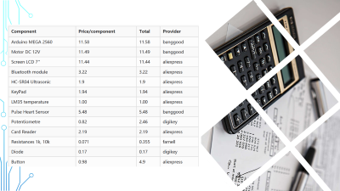
COMPONENTS
BUDGET

Slide 4

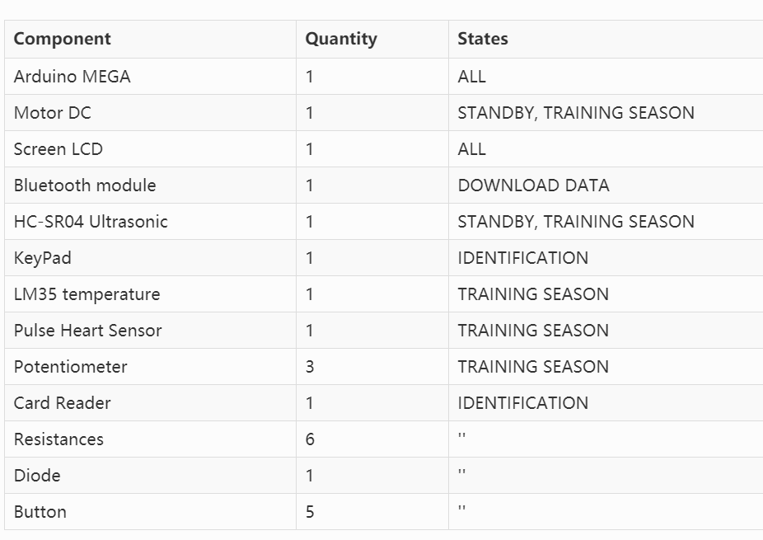

Slide 5
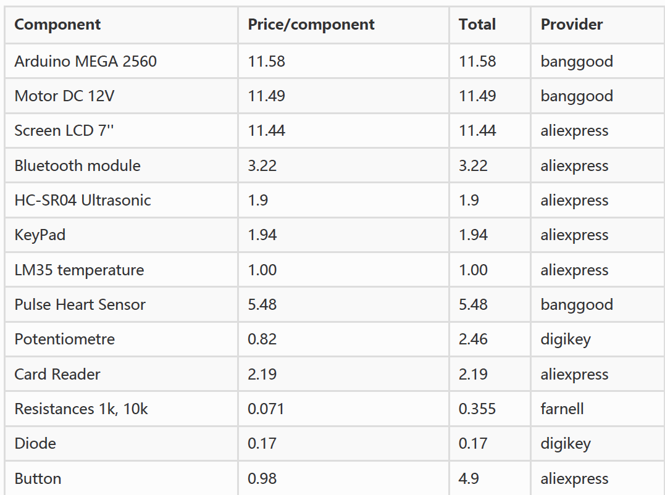


Slide 6
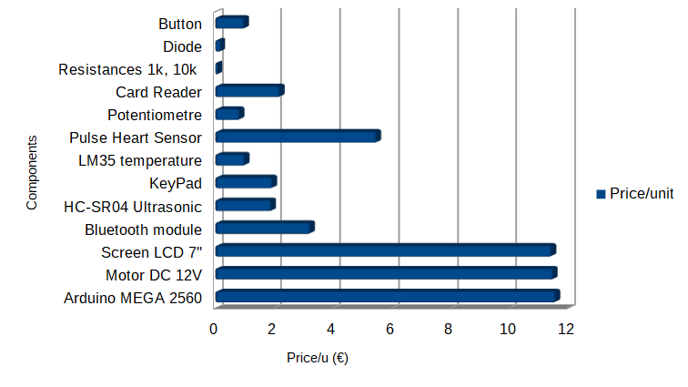

Slide 7
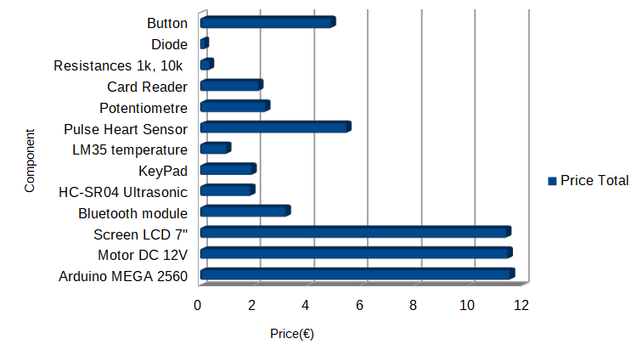

Slide 8
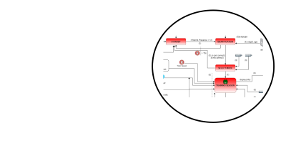
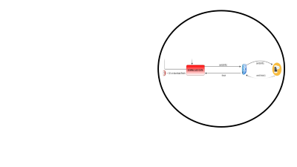
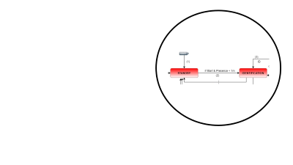
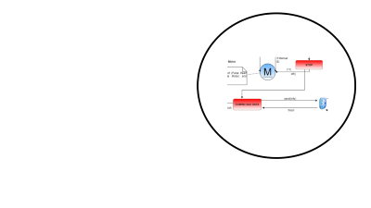
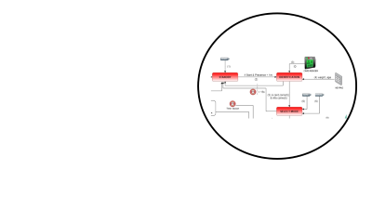
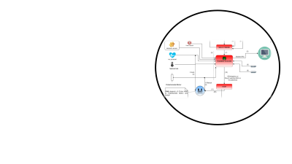
Flow diagram

Slide 9
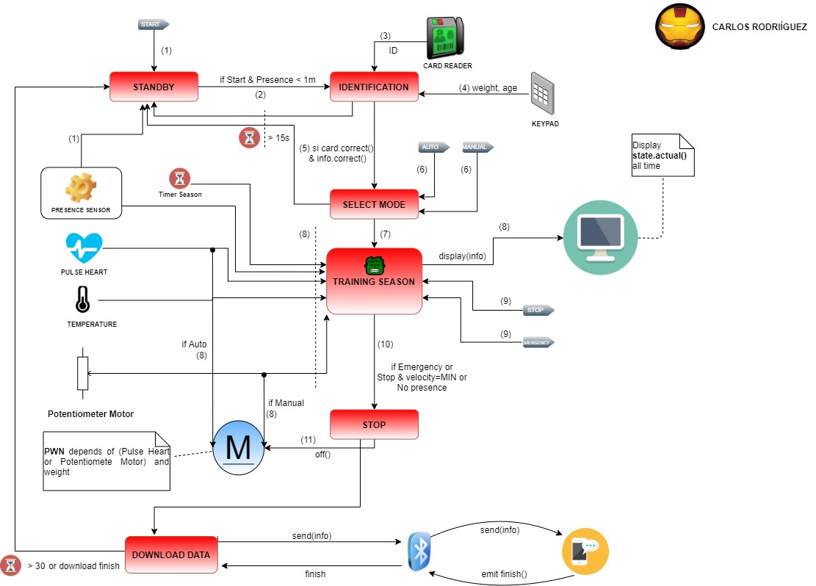
STANDBY
Motor DC is off
In the case, if we push the button START and we are less than 1 meter, we'll pass to IDENTIFICATION

Slide 10
IDENTIFICATION
We check the ID with our card
Write our weight and age
The Control checks the input data
If the input data is correct we go to the next state, SELECT MODE
Exception
We have expired the time (15s) to identify
The input data is invalid
If any exception occurs, we come back to the state STANDBY

Slide 11
SELECT MODE
We choose the control auto o control manual with the corresponding buttons
When we choose it, we pass to TRAINING SEASON
Exception
We have expired the time (15s) to select mode
If the exception occurs, we come back to the state STANDBY

Slide 12
TRAINING SEASON
We constantly read the data from the sensors: temperature, pulse heart, time, presence sensor and speed. The last value depends on our weight and our previous choice, pulse heart it was Auto or potentiometre motor it was Manual. We display this information in LCD.
Exception
We press the button Emergency or Stop and the speed is the minimum
The presence sensor does not detect a presence within 1 meter
If any exception occurs, we pass to the state STOP

Slide 13
STOP
In this state we'll stop the motor DC if occurs the exception_button() or we'll reduce the motor speed gradually if occurs the exception_no_presence()
Once the engine is turned off, we go to the next state DOWNLOAD STATE

Slide 14
DOWNLOAD STATE
Finally, we send the training data to the mobile via bluetooth
Exception
We have expired the time (15s) to download the data
We finish sending the data
If any exception occurs, we pass to the state STANDBY

Slide 16
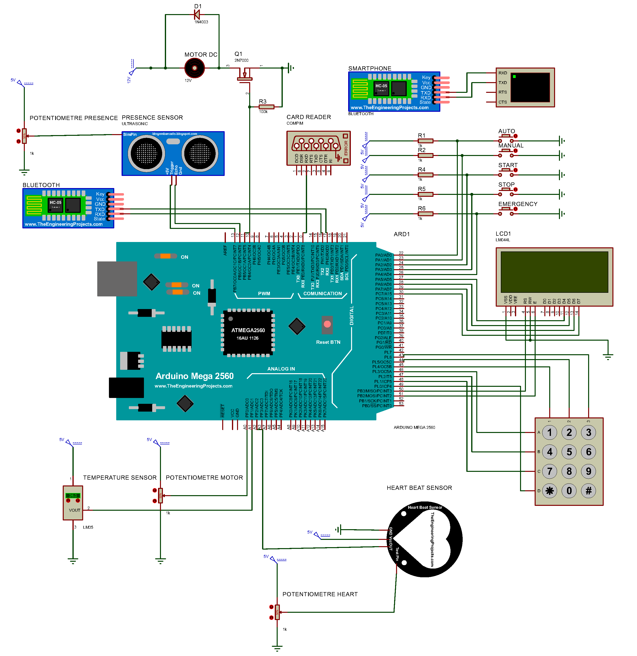

Slide 17

TESTS
TEST EXCEPTIONS
TEST DATA
TEST USER EXEMPLE

